Slide 1
Modeling the Motion of Fungus Gnat Larvae
Tzu-Chi Yen & Kristen Schneider
Apr. 24, 2019

Slide 2
Notes:
https://www.planetnatural.com/pest-problem-solver/houseplant-pests/fungus-gnat-control/
Larvae: ¼ inch in length, shiny black head, elongated body that Is wither white or transparent. Abundant in damp, rich soils, and feed on organic matter (e.g. grass, fungus, mulch, mold, plant roots, etc.). Full lifespan == 3-4 weeks, but larvae have a 2 week life span, chew on plant roots.

Slide 3
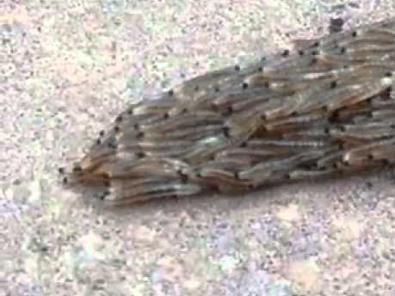
[https://www.dailymail.co.uk/sciencetech/article-2737816/Snakes- No-writhing-mass-hundreds-fungus-gnat-LARVAE-searching-shelter.html]
Notes:
Original video:
Large mass of fungus gnat larvae moving as a collective unit
With some split

Slide 4
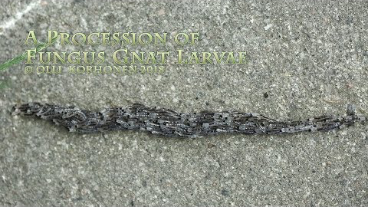
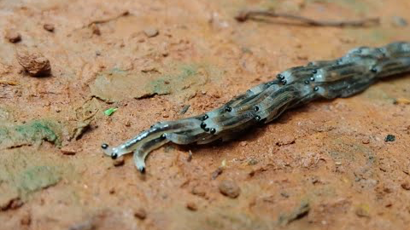
[https://www.youtube.com/watch?v=TU2Q8kVs0hU]
[https://www.youtube.com/watch?v=6MwYvLaJ6Ho]
Notes:
Other videos (more clear)
Leap frog motion seems to be more of a function of weight than a conscious decision…
The split doesn’t really happen in these videos, (starts in the top and then comes back together)
Travel in packs to look more like a snake so that birds don’t attack/eat them

Slide 5
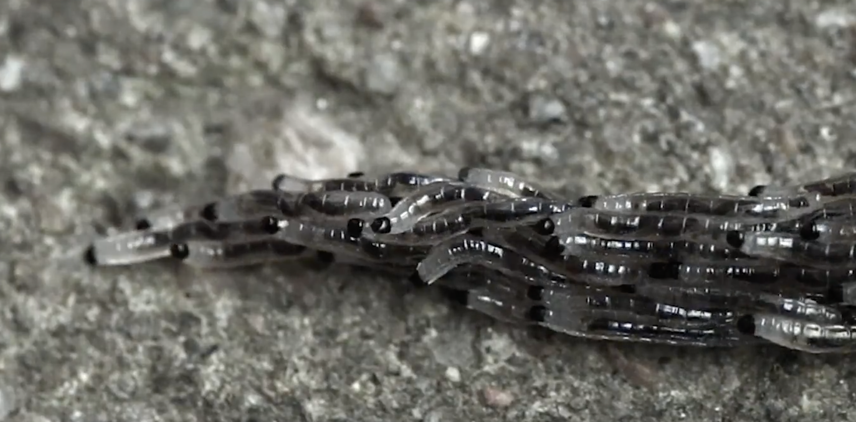
WHY?
STACKED CRAWLING
Appear bigger/more solid to predators (e.g. birds).
Protect certain agents in the middle.
Transportation of some item (e.g. food).
HOW?
Individual forward movement influenced by:
Depth (weight)
Uniform directionality (pre-split) influenced by:
closest neighbors
moisture

Slide 6
WHY?
SPLITTING
Moisture
Weight threshold
HOW?
Front individual(s) become informed
Moisture content
Weight

Slide 7
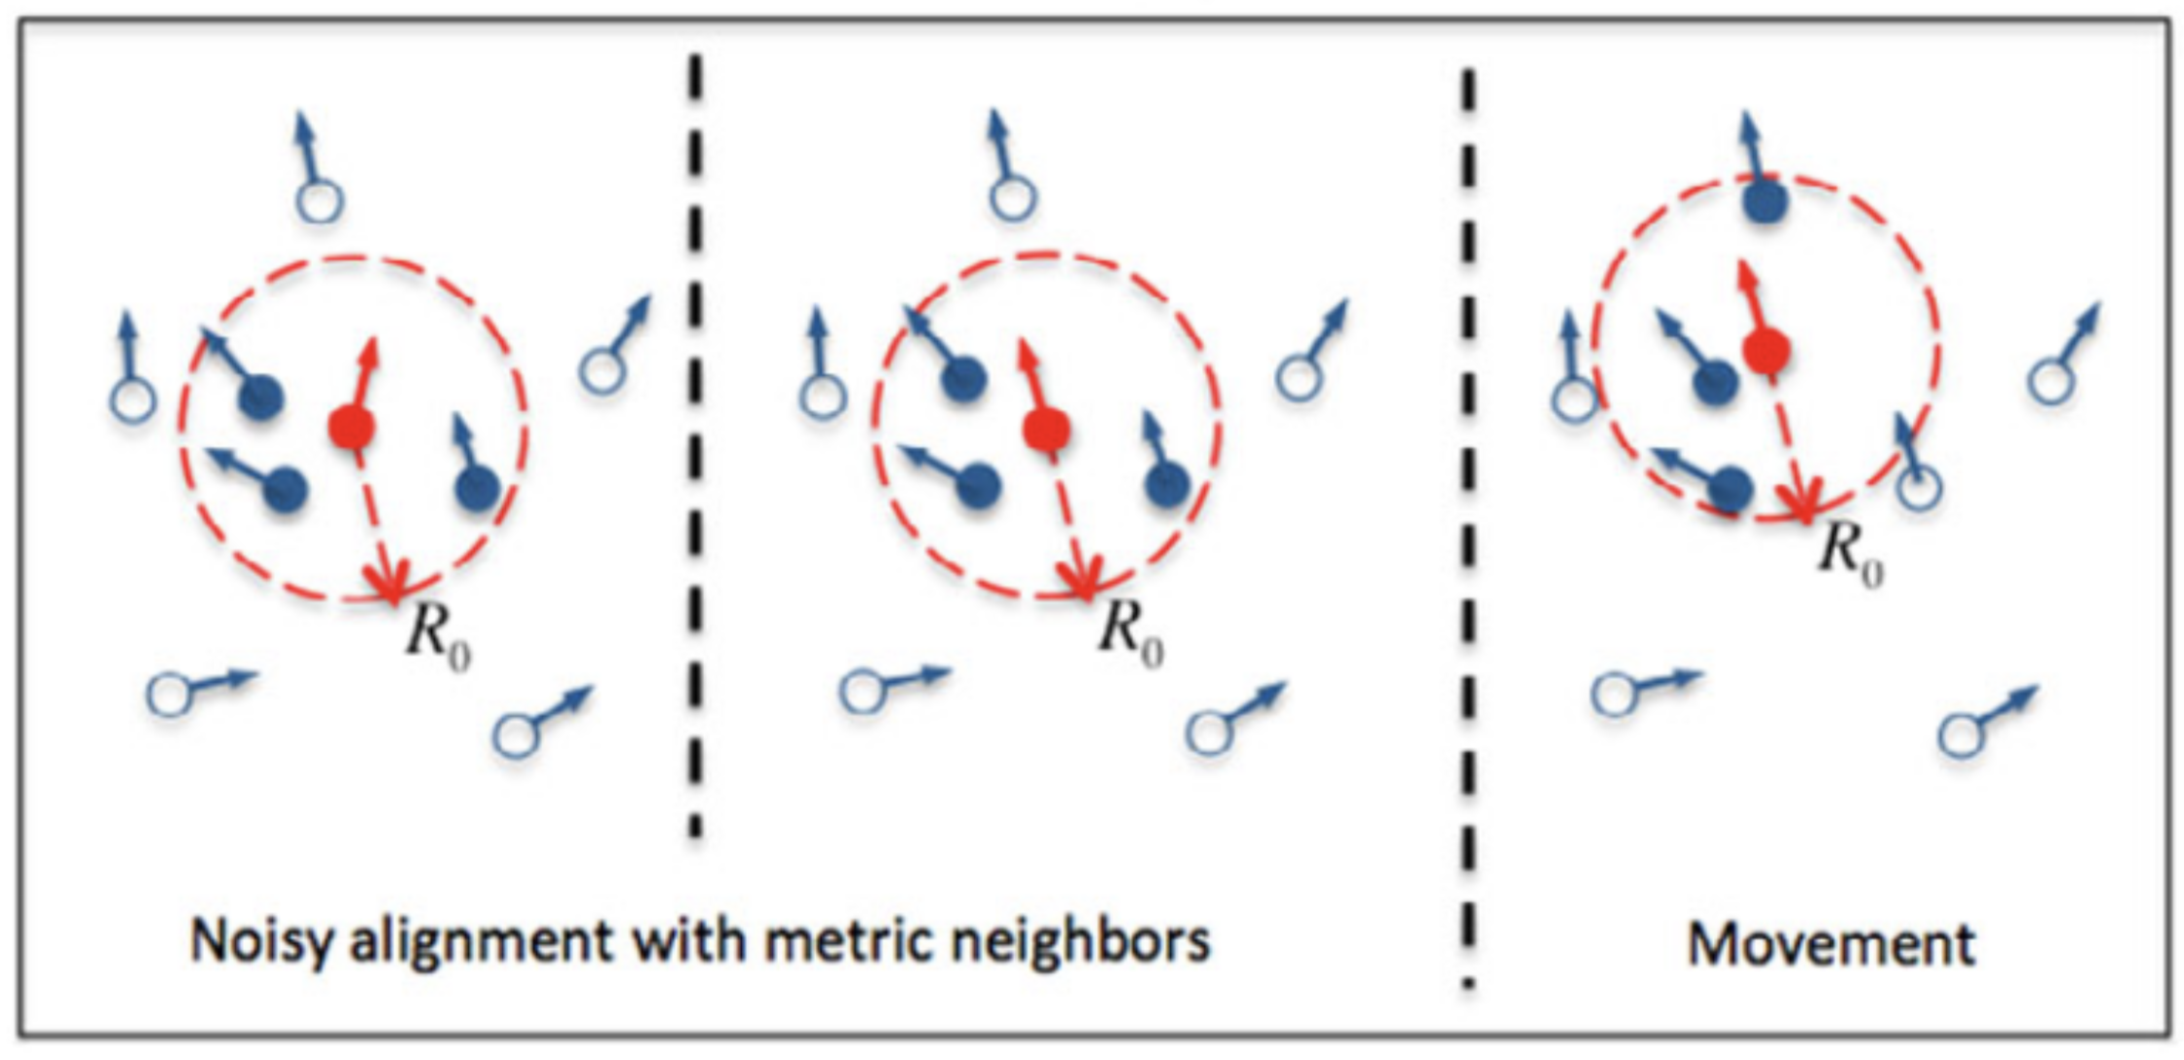
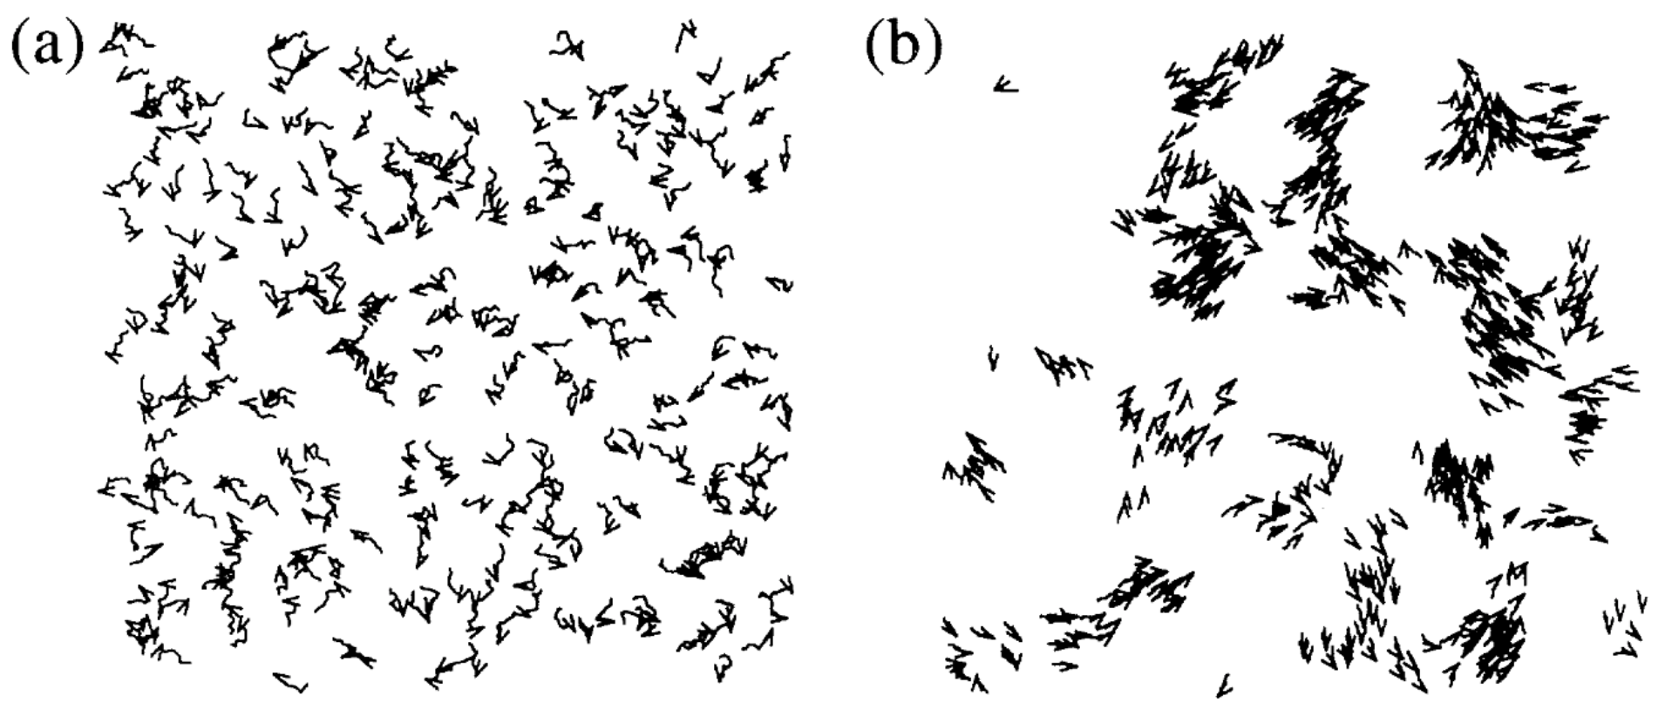
The Vicsek Model (1995)
Rotational symmetry (no transport)
Kinetic phase transition
(by increasing agents or increasing the “Radius”)
Collective motion (finite net transport)
Example: https://97amarnathk.github.io/VicsekModel/

Slide 8
Searching for a minimum model that reproduce the behavior …
 | Vicsek Model | Yen-Schneider model
Dimension | 2D | 2D (pseudo 3D)
Depth | -/- | Binary (0 or 1); higher in pile, higher angular noise
Initial agents distribution | Uniform (sparse; average mutual distance > R₀) | Uniform within an ellipse (dense; average mutual distance ~ R₀)
Sensible radius (R₀) | Isotropic | Anisotropic (anterior or posterior)
Velocity | Constant | Constant or 0
Angular noise | Isotropic | Anisotropic
Vicsek equations of motion
(we update 3 values in each time step):
Our invention (for the 3rd dimension):
Strictly increasing function of _depth_
That is, upper larva are more active!

Slide 9
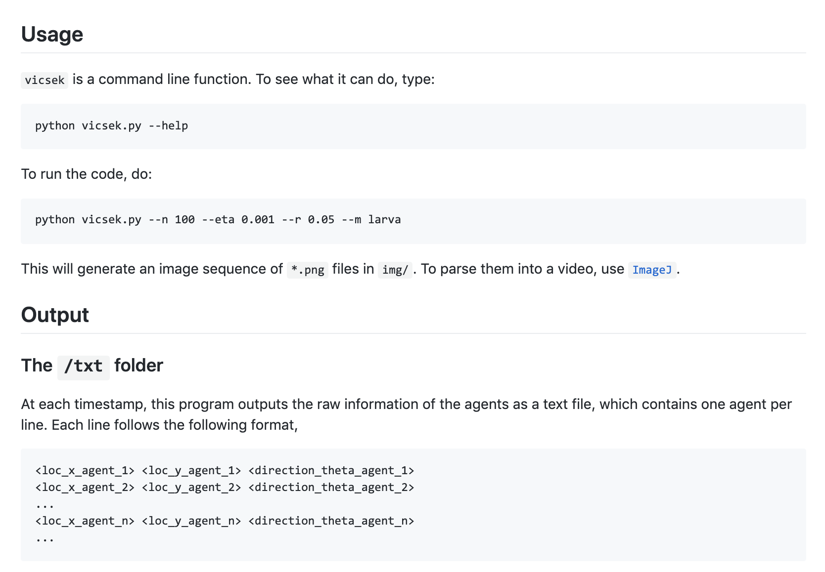
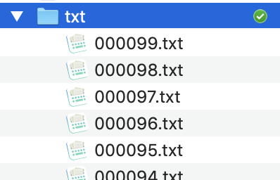

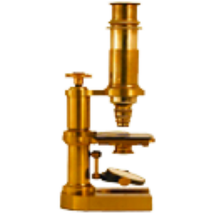
Python code
(Math + Physics)
_matplotlib_
Read by ImageJ
ImageJ: https://imagej.nih.gov/ij/

Slide 10
TAIL
HEAD
FRONT
DIRECTION
RADIUS
BACK
AGENT POSITION
We reproduced the leapfrog behavior.
But not the splitting
(coupling between layers?).

Slide 11
Future Work
Mention Any bug fixes
Anything we talked about but haven’t implemented
new ideas:
Front agent picks next direction based on moisture
When “average weight” exceeds some amount, split
If no weight on top, move stochastically in all directions until you come into contact with another larva. Then move in that direction.

Slide 12
Acknowledgments
Dr. Orit Peleg (CU Boulder & BioFrontiers Institute)
Code: Alexandra Signoriello (Yale), whose vicsek_model repository on GitHub inspires the design pattern of this project.

